Slide 1
ALGEBRA 3
Day 40

Slide 2
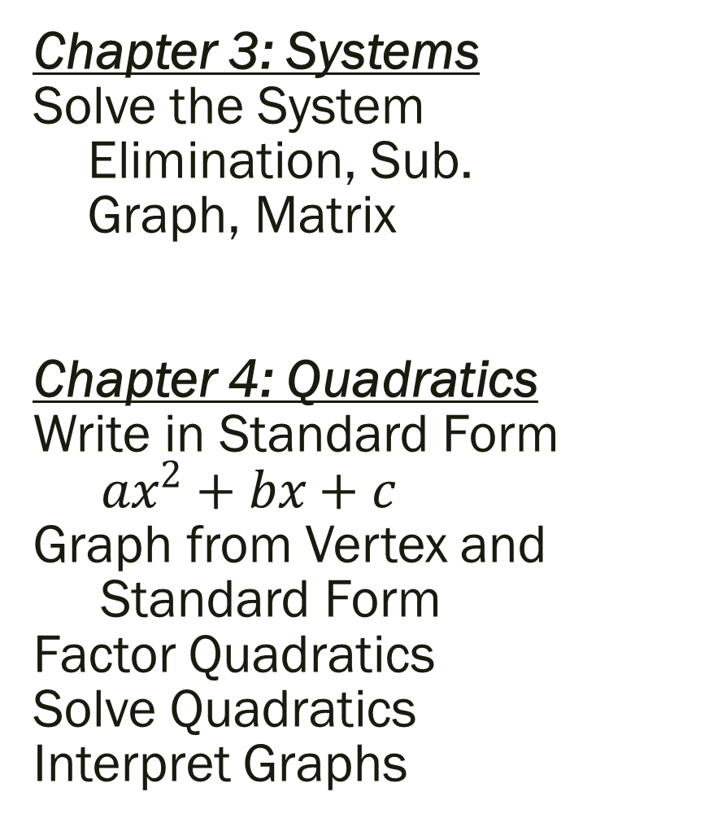
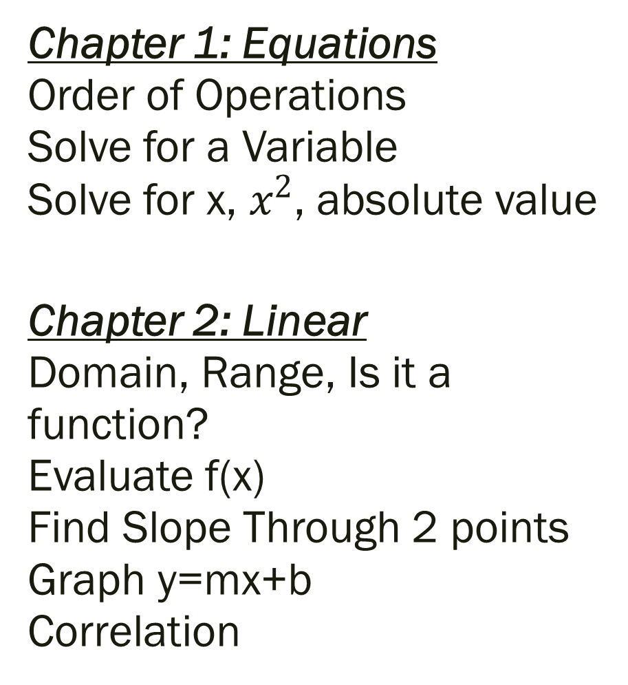
Things to Study for Mid-Term Final
Chapter 1: Equations Order of Operations Solve for a Variable Solve for x, $x^{2}$, absolute value
Chapter 2: Linear Domain, Range, Is it a function? Evaluate f(x) Find Slope Through 2 points Graph y=mx+b Correlation
Chapter 3: Systems Solve the System Elimination, Sub. Graph, Matrix Chapter 4: Quadratics Write in Standard Form ${ax}^{2}+bx+c$ Graph from Vertex and Standard Form Factor Quadratics Solve Quadratics Interpret Graphs

Slide 3
Chapter 1 Expressions, Equations and Inequalities
Level 2
Order of Operations (1 problem) Solve for indicated variable (4 problems) Solve for x – combine like terms (1 problem)
Level 3
Solve for x – quadratic and absolute value (2 problems)
Level 4
Write and solve your own equation (1 problem)

Slide 4
Chapter 2 Functions, Equations and Graphs
Level 2
Identify Domain, Range and State if it is a Function (1 problem) Is a given function linear? Evaluate f(x) (1 problem) Write in Slope-Intercept Form (1 problem)
Level 3
Find slope through two points (1 problem) Graph the line (1 problem)
Level 4
Real life story problem with correlation and/or absolute value (1 problem)

Slide 5
Chapter 3 Linear Systems
Level 2
Solve the system with 2 variables (2 problems)
Level 3
Solve the system with 3 variables (1 problem)
Level 4
Create and solve a system of equations (1 problem)

Slide 6
Chapter 4 Quadratic Functions and Equations
Level 2
Factor the following (2 problems) Graph with at least 5 points (2 problems) Factor completely (2 problems)
Level 3
Solve the equation using any method (2 problems) Solve the quadratic story problem (1 problem)
Level 4
Solve the equation (1 problem)

Slide 7
Algebra 3 Final Review Assignment
Students do not need to attempt all problems, they need to work on the ones in which they need the most practice. **If work is done in their notebook, it will be considered a part of their notes, and will be able to be used on their final!
Focus on Level 2 Type of Problems first!!!!

Slide 8
Algebra 3 Final Review Assignment
Chapter 1
Page 50 #18-32 Page 53 #1-3
Chapter 2
Page 123 #3-30, 34-49 Page 127 #1-26, 31, 33-36
Chapter 3
Page 184 #3-19, 23-30 Page 187 #1-7, 9-12, 14
Chapter 4
Page 268 #4-16, 21, 27, 29-31, 33-48 (any method), 61-64, 69-71, 74-77, 80-83

